Slide 1
A Tour to Statistically Informed Interactive Maps
Researcher: Carina Zheng
Supervisor: Richard Penny
With Statistics NZ

Slide 2
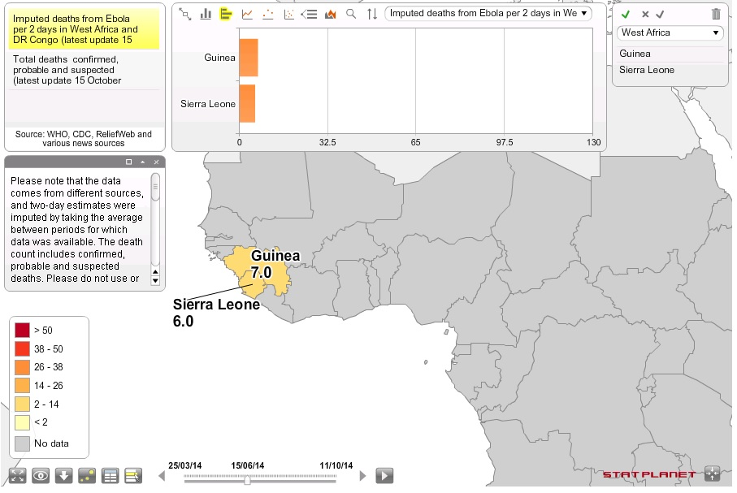
What we got
Outline
What we got
What we
have done
About this map, I think…
Good ☺
Many functions
Explanations and notes are available
Fancy looking
Bad ☹
Too much on one page
Top panel blocks part of the map
What do you think?
How to make a good statistical interactive map?
After browsing website and practices…

Slide 3
What we have done
Outline
What we got
What we
have done
About this map, I think…
Good ☺
Many functions
Explanations and notes are available
Fancy looking
Bad ☹
Too much on one page
Top panel blocks part of the map
What do you think?
How to make a good statistical interactive map?
After browsing website and practices…

Slide 4
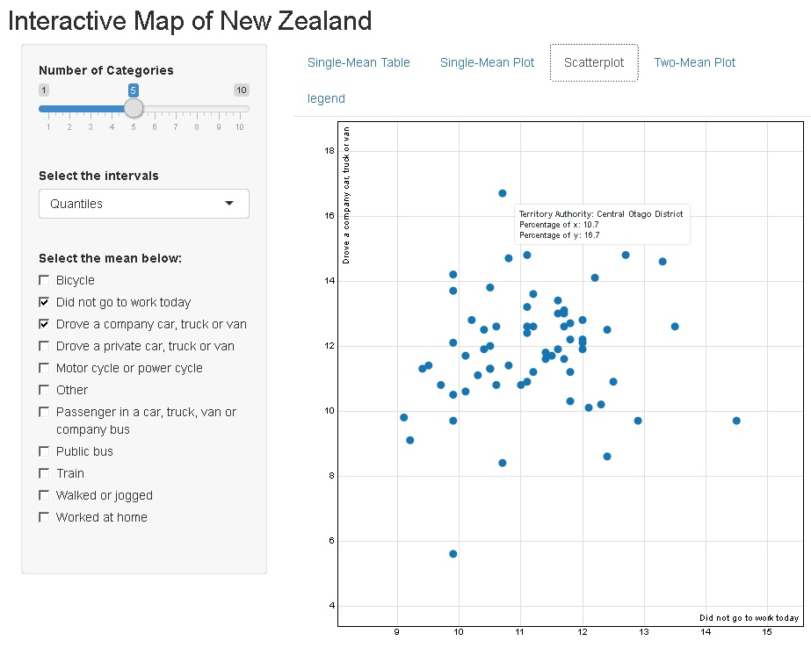
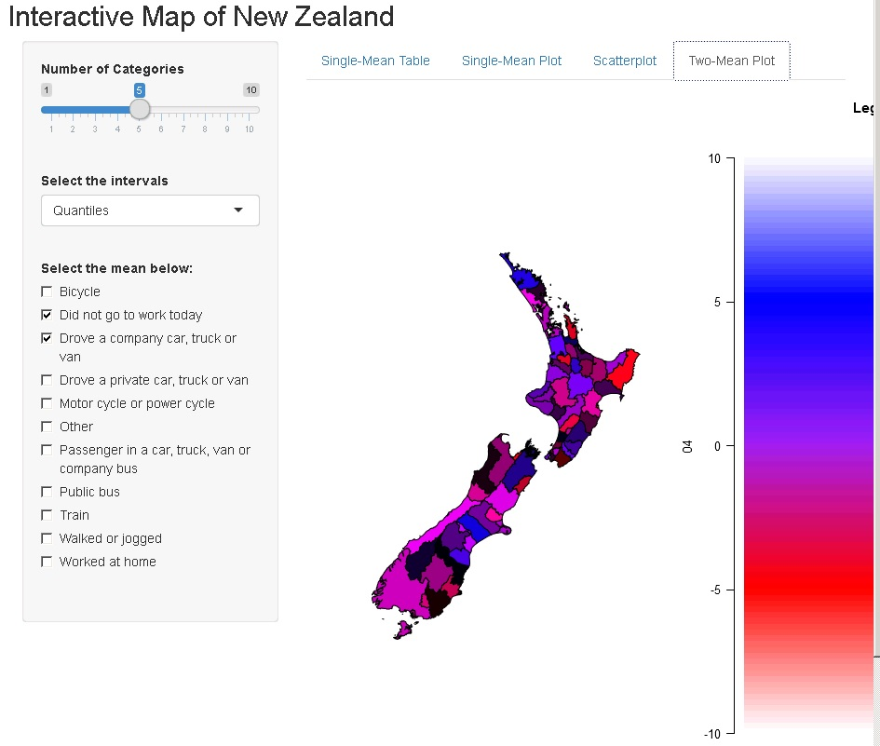
What we have done
Outline
What we got
What we
have done
About this map, I think…
Good ☺
Many functions
Explanations and notes are available
Fancy looking
Bad ☹
Too much on one page
Top panel blocks part of the map
What do you think?
How to make a good statistical interactive map?
After browsing website and practices…

